Slide 1
Optimization
Preliminary Design Report
May 11, 2020

Slide 2
Agenda
Project Goals
Previous Design Overview
Current Design Overview
Design Intuition
How To…
Salient Design Decisions
Problems and Future Work

Slide 3
Project Goals
Over-arching Goal
Find the most energy-efficient way to cover a given track.
Original Goal
Find best speed profile for a given path
Problems
Will the driver adhere to that path? How will you get data for a particular path beforehand?
Revised Goals
Find best path to follow along a given track.
Find most optimum speed profile.
Have the ability to recompute.

Slide 4
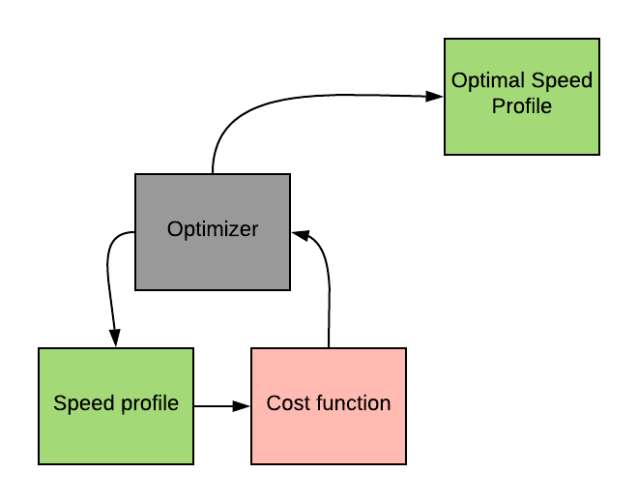
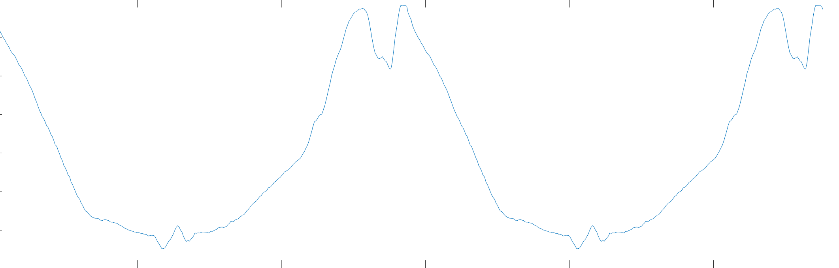
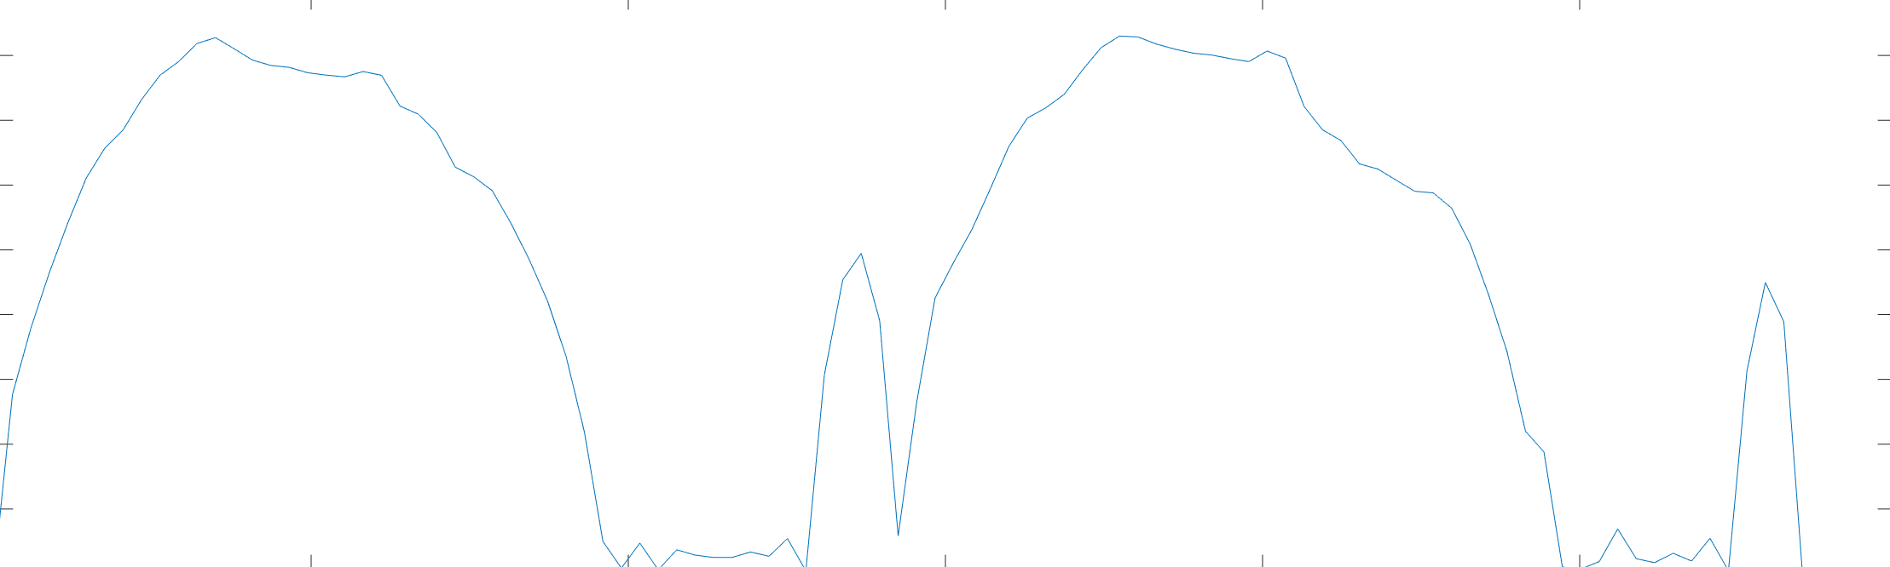
Previous Design Overview: MATLAB
Input Path
Find the Cost of Going Across a Path with A Given Speed Profile
Input Into In-Built MATLAB Optimizer
Output Speed Profile With Minimum Cost

Slide 5
Current Design Overview: Python
Interpolate Data
Create Ability to Get Information for Anywhere on Track
Create a Nearest Point Query Mechanism
Input Track Data (Inner and Outer)
Get Relevant Track Data for Current Location
Find Best Way to Move Forward
Compute New Location If Race Isn’t Finished
Back-trace and
Output Most Energy Efficient Path

Slide 6
Design Intuition: Process
Know Best Way To Get To All Speeds At T
Speed Limit
Known
S
Unknown
0
T
Time Limit
Find Best Way To Get To Reach Speed S at T+1 from Previously Computed Best Ways

Slide 7
Design Intuition: Result
Speed Limit
Known
0
Time Limit
Calculate best “best way” i.e. drive with minimum cost out of all possible drives.
Should usually be the drive that ends with speed 0 due to law of conservation of energy!
Best Ways To Reach All Speeds at Max Time

Slide 8
How To…
… calculate energy between two points?
Energy function using simple mechanics.
… compute a path from all of this?
Try all possible steering angles with all possible speeds and find the most energy-efficient combination of the two at each point.
… ensure car actually moves forward instead of staying at one place and using 0 energy?
Minimize cost instead of energy where cost is the sum of the energy consumed and the deviation from the distance that should be covered
… ensure car stays inside track and doesn’t move after finishing the race?
Make cost infinity if the car’s new location is outside bounds or if the race is over.

Slide 9
Salient Design Decisions
Implemented Class: InterpolatedTrack as a sub-class of KDTree. Why? For most efficient query.
Implemented Class CostNode to maintain information. Why? Sacrifice a little space optimization for more readable and simpler code!
DEMO

Slide 10
Problems and Future Work
Speed!!!!!
Create an algorithm fast enough to update in real time.
Testing
Come up with possible ways to test and verify results.
Create a proper test script.
Integration with Driver Dashboard to update in real-time.
How much information does the driver want?
Questions?

